Slide 1
Test your code quality with
Pester and PSScriptAnalyzer
Leo Visser

Slide 2

Many thanks to our sponsors:

Slide 3


Leo Visser
Cloud Consultant @ OGD-ict diensten
IAC, CI/CD, Automation, Agile, DevOps
Twitter: @autosysops
Blog: www.autosysops.com
Notes:
2 (2)

Slide 4
Agenda
PSScriptAnalyzer - Linting
Pester - Testing
Combining
Exemptions
CI/CD
Notes:
1 (3)

Slide 5
Code Quality
Formatting
Unused code
Preferred ways
Notes:
2 (5)

Slide 6
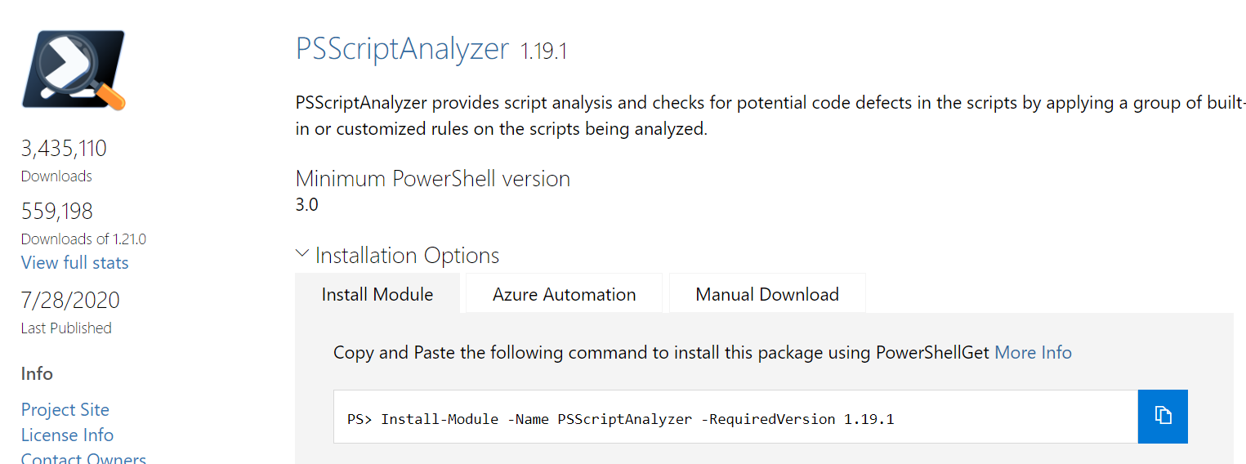
PSScriptAnalyzer
Notes:
1 (6)

Slide 7




PSScriptAnalyzer
Script
Linter
Outcome
Notes:
3 (9)

Slide 8
Notes:
2 (11)

Slide 9
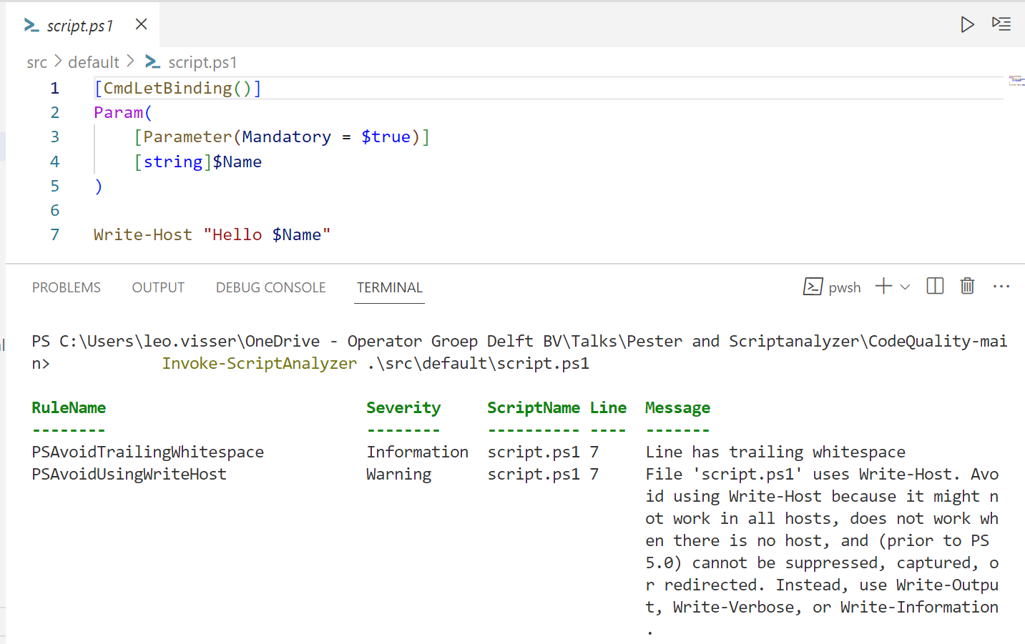
PSScriptAnalyzer

Slide 10
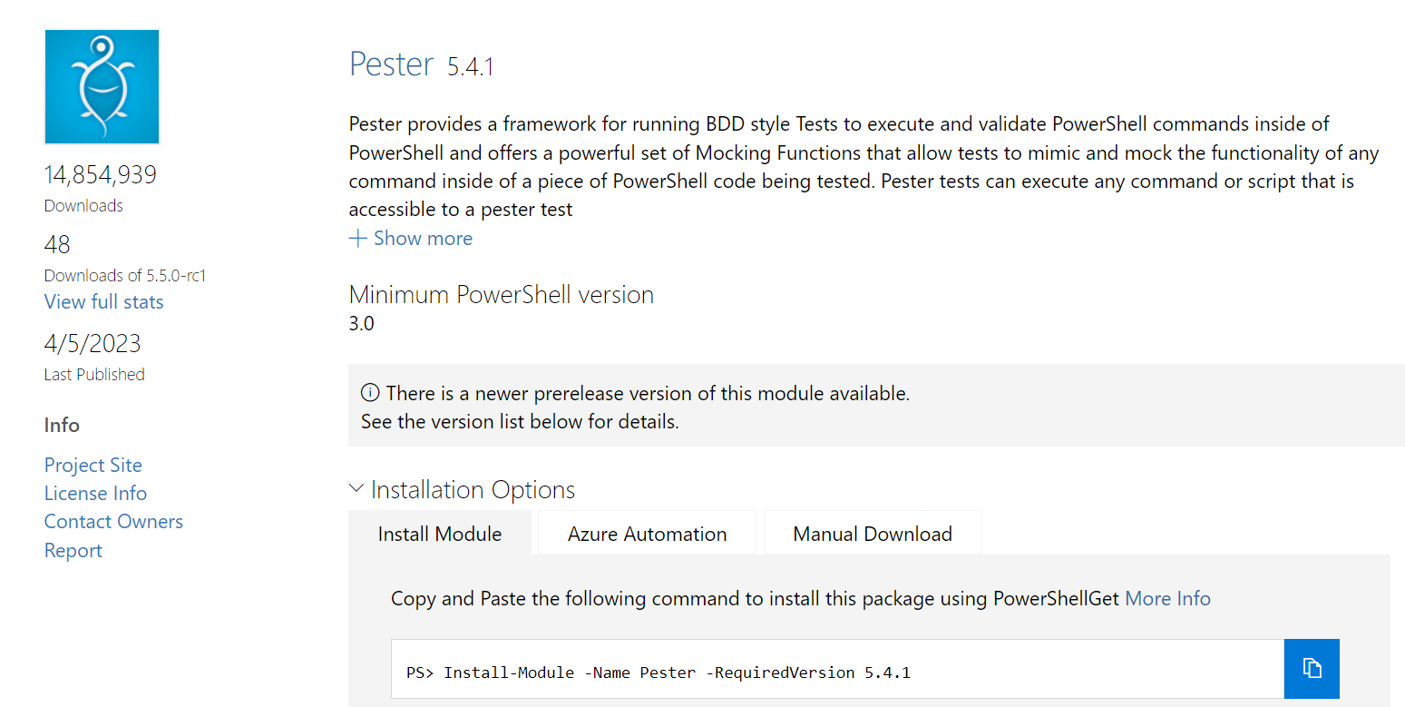
Pester
Notes:
1 (13)

Slide 11

Pester
Do command
Compare output
Script
Testing
Report
Notes:
2 (15)

Slide 12
Combining
Simple Version
Notes:
2 (16)

Slide 13
Notes:
2 (18)

Slide 14
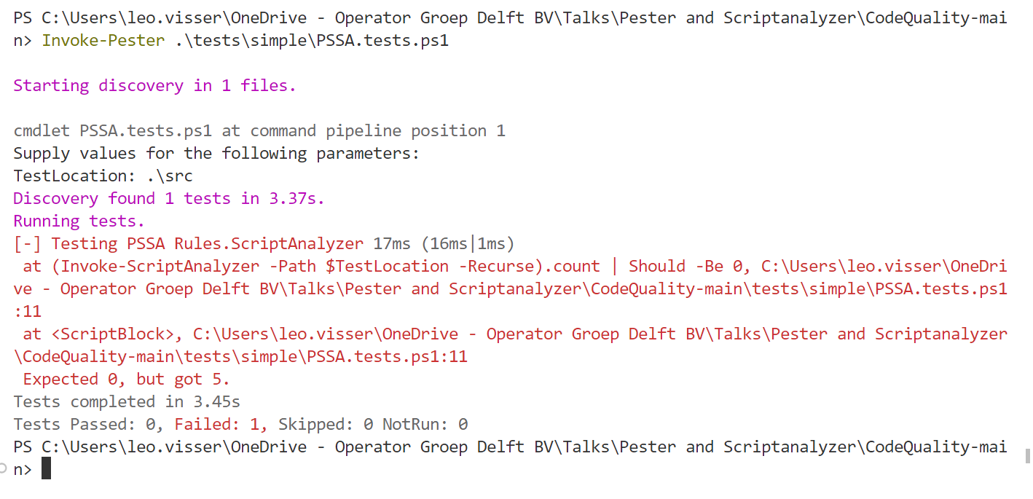

Slide 15
Combining
Simple Version
Advanced Version
Notes:
1 (19)

Slide 16
Notes:
4 (23)

Slide 17
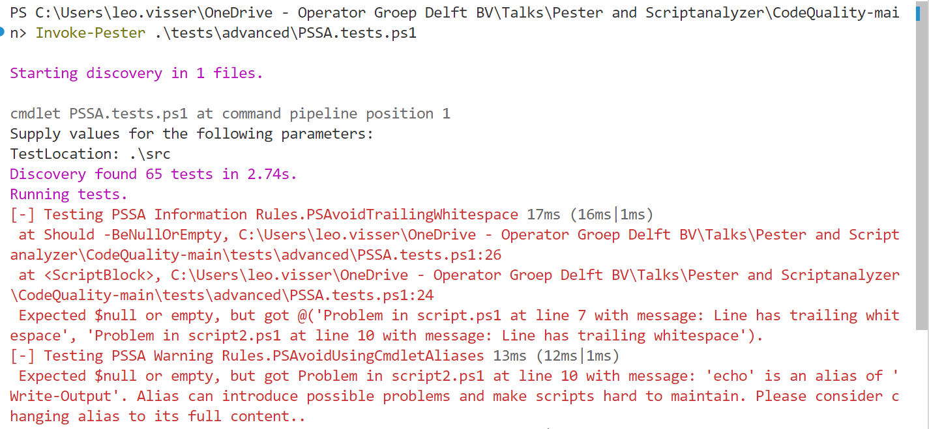

Slide 18
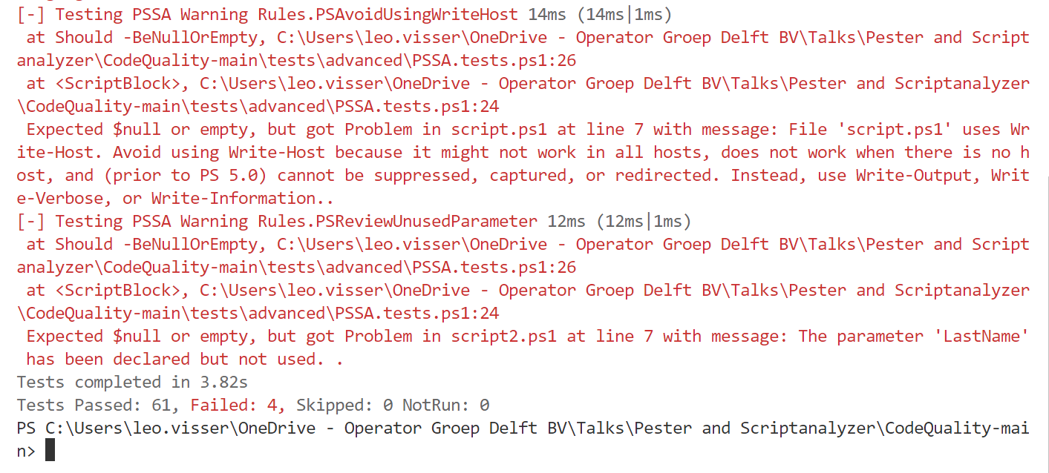

Slide 19
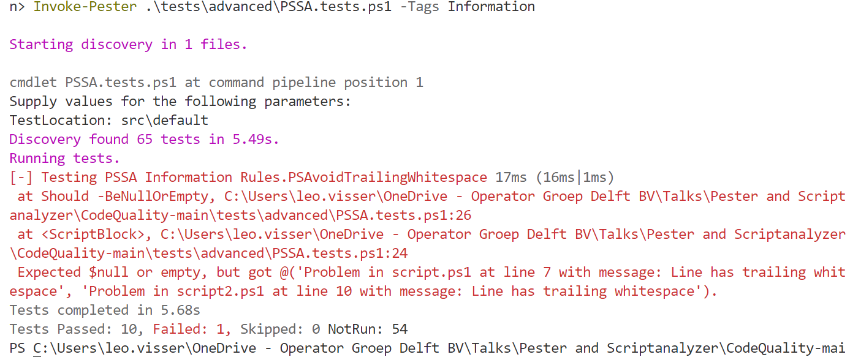

Slide 20
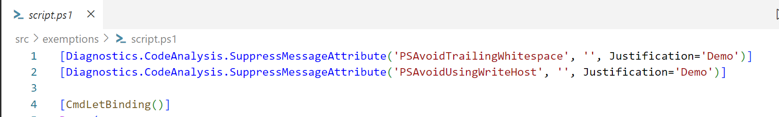
Excemptions
Exclude checks in specific files
Notes:
2 (25)

Slide 21
Demos
Notes:
1 (26)

Slide 22
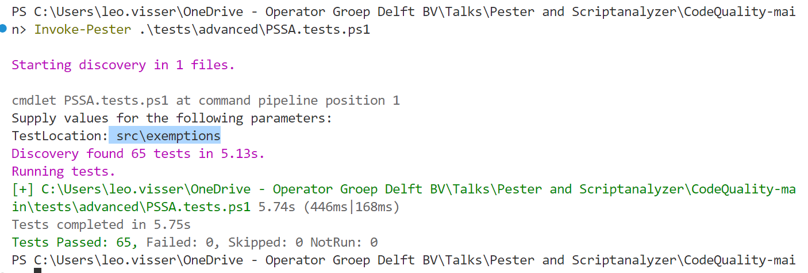

Slide 23


CI/CD
Pipeline to automate
Pull Request build validation
Notes:
2 (28)

Slide 24
Demos
Notes:
2 (30)

Slide 25
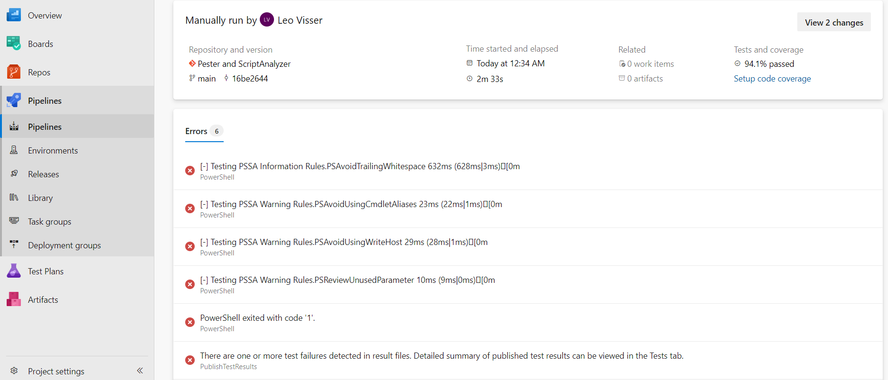

Slide 26
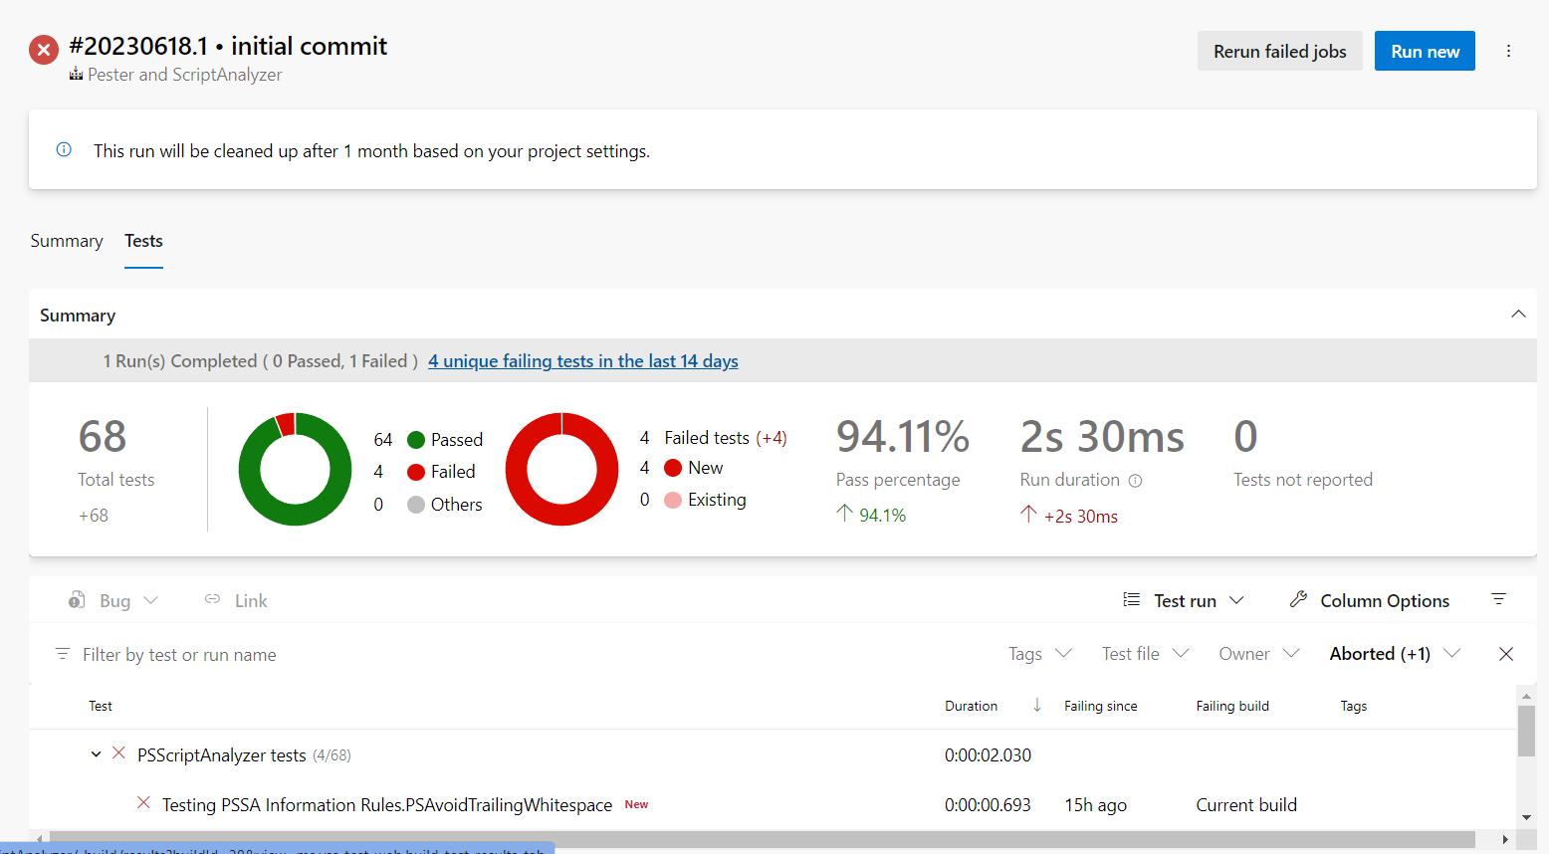

Slide 27
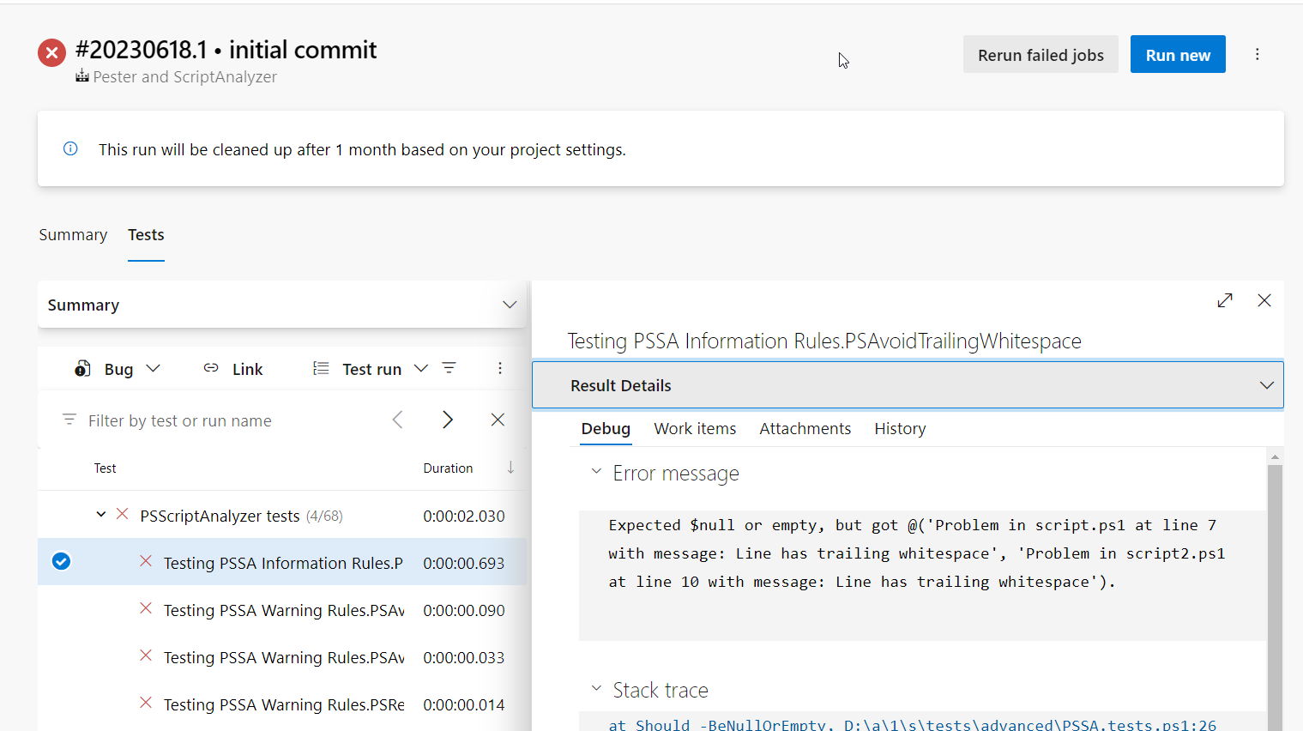

Slide 28
Q&A
15 minutes
Notes:
end

